Slide 1
CHESS GAME : PROJECT DISCRIPTION DOCUMENT
OBJECT ORIENTED PROGRAMMING
GUIDED BY:- DR.R.ANIL KUMAR

Slide 2

OBJECTIVE
To create a functional Chess game that can be played by two players.
The program should allow players to move their pieces by specifying the source and destination squares and check if the move is valid or not according to the rules of Chess.
The program should also detect if a player is in check

Slide 3
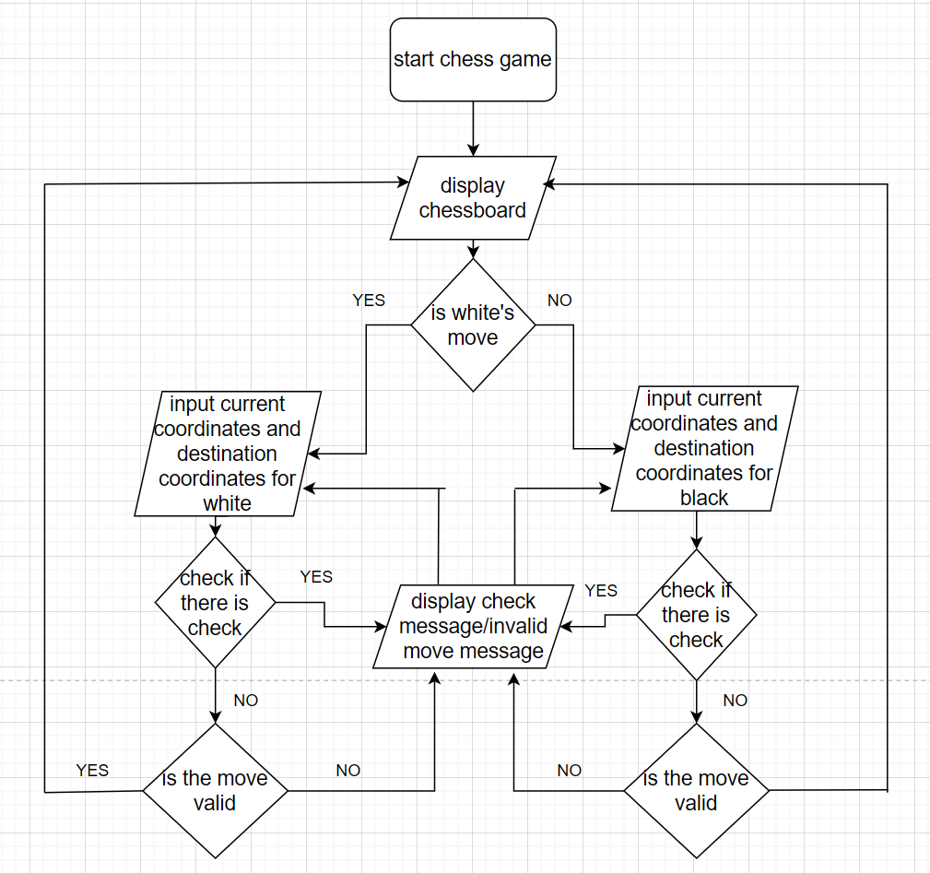
Flow chart

Slide 4
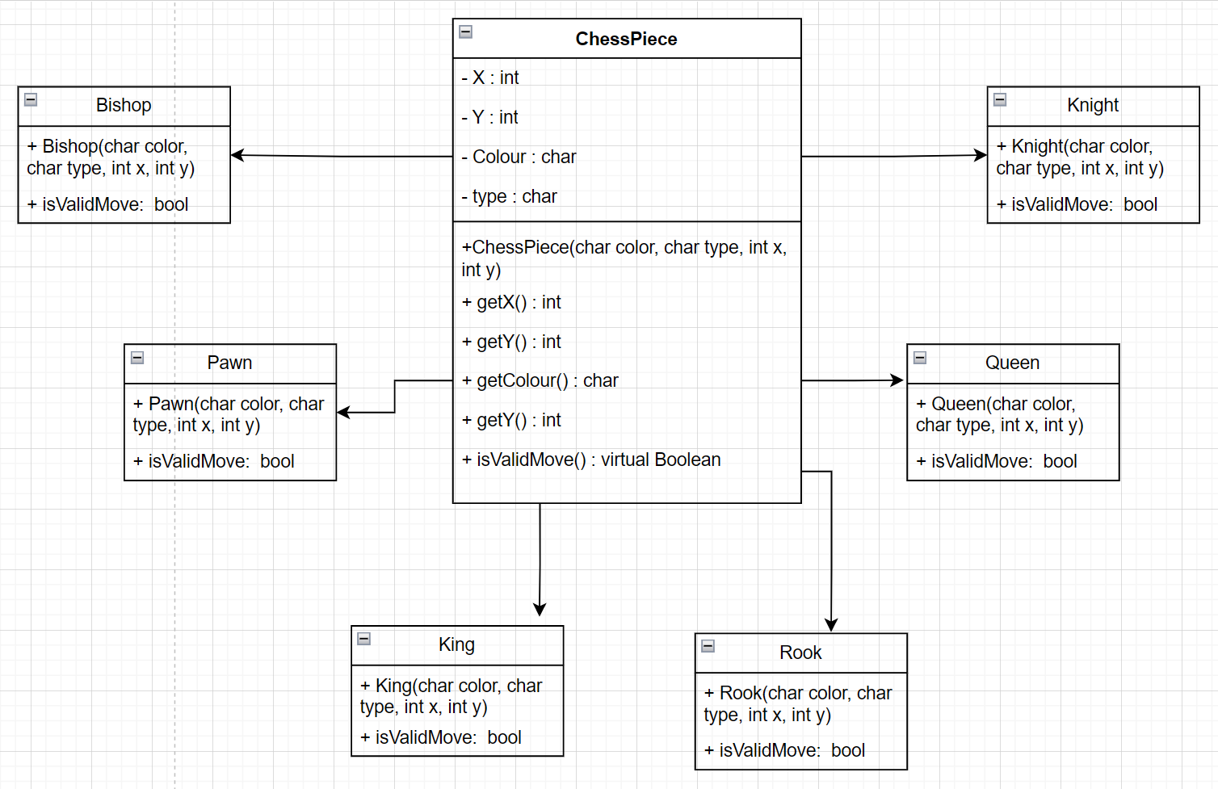
Inheritance diagram

Slide 5
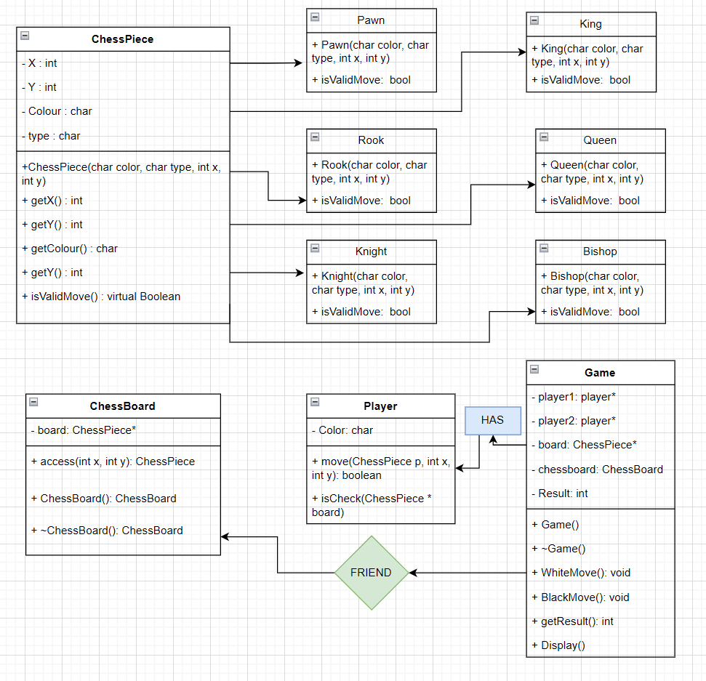
Class diagram

Slide 6
Description
This code is a C++ program that simulates a simplified version of chess. The program defines a ChessPiece class, which is an abstract base class for different chess pieces, and defines six classes derived from the ChessPiece class for the Pawn, Rook, Bishop, King, Queen and Knight. Each derived class implements its own version of the isValidMove() function. which is overridden by it’s derives classes, allowing the function to behave differently depending on the type of the object being referred which allows flexible and extensible code .
The program uses a 2D vector of ChessPiece pointers to represent the chess board, where each element of the vector represents a square on the board. The program takes input from the user in the form of two pairs of integers, which represent the starting and ending positions of the piece that the user wants to move. The program then checks if the move is valid based on the rules of the specific piece being moved, and updates the board accordingly if the move is valid.

Slide 7
Description
Before checking if the move is valide, first thing is to check if there are any ‘checks’ with the King. For doing so isCheck function is called by the Game class using the Player object which takes reference of the 2D vector Chessboard. The function starts by searching for the position of the player's king on the board. It iterates over all the squares on the board and checks if there is a non-null chess piece of type 'K' (king) with the same color as the player's.
If the player's king is found, the function then checks whether any of the opponent's chess pieces can attack the king. It iterates over all the squares on the board and checks if there is a non-null chess piece with a different color than the player's. If such a piece exists and can attack the king, the function returns true indicating that the king is in check.
If no opponent's piece can attack the king, the function returns false indicating that the king is not in check.

Slide 8
Description
To check if a move is correct or not, Move function is called from the respective players which takes a reference to a 2D vector representing the chessboard, and four two integers representing destination coordinates. The function checks if the move is valid for the piece at the starting position, and if so, moves the piece to the destination position on the board by creating a new ChessPiece object depending on the type of the piece being moved and also delete the original ChessPiece object from starting position.

Slide 9
THANK YOU
TEAM MEMBERS:
121CS0001
121CS0003
121CS0025
121CS0060

